Slide 1
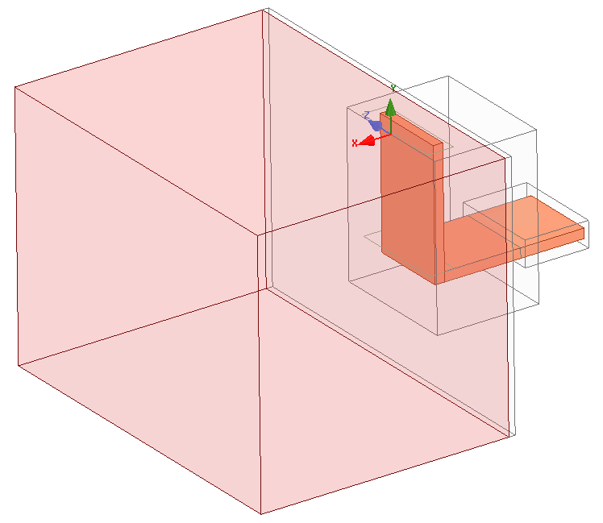
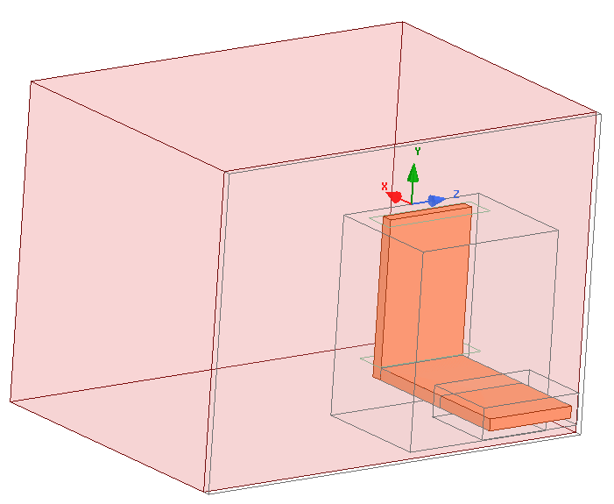
1 strap – lossy water eps_{r}=(81-1j*$losses)
Radiation BCs

Slide 2
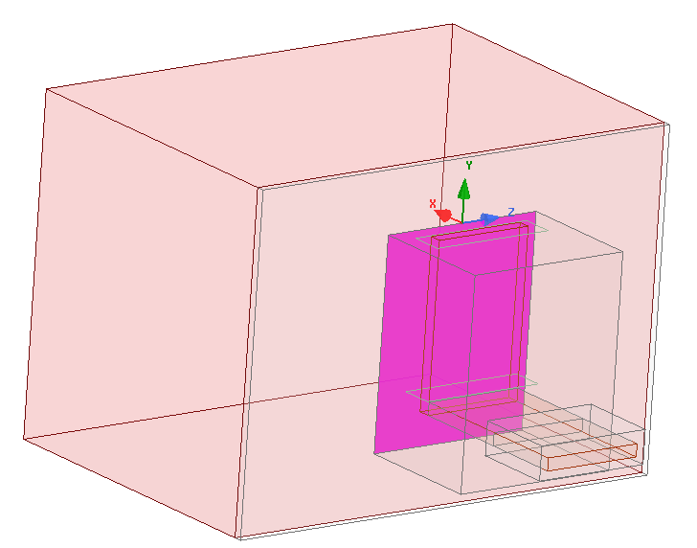
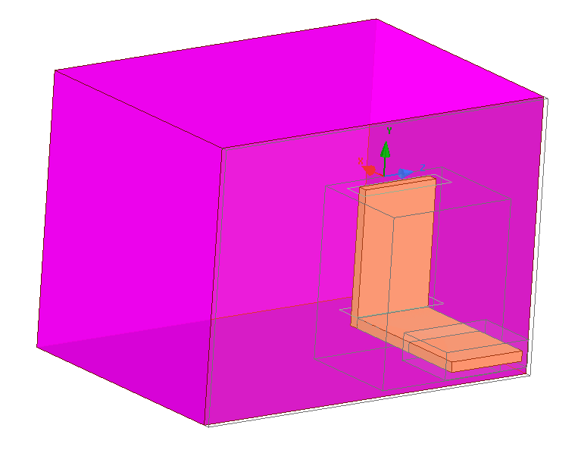
Parameters
P_transferred : int(Re(Poynting))
P_radiated : int(Re(Poynting))
Convergence criterium on Z: 1% real and im parts

Slide 3
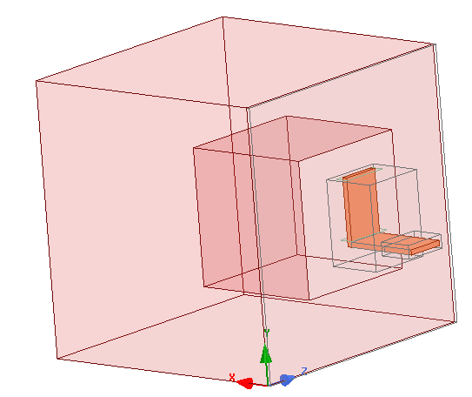
Step 1 : size of the plasma box
Increasing the propagation medium box size to see the size at which the port impedance converge
losses = 0 → Plasma1=plasma2
Radiation BC
Plasma 2
Plasma 1
d
losses = 0 → Plasma1=plasma2
Radiation BC
D
2D

Slide 4
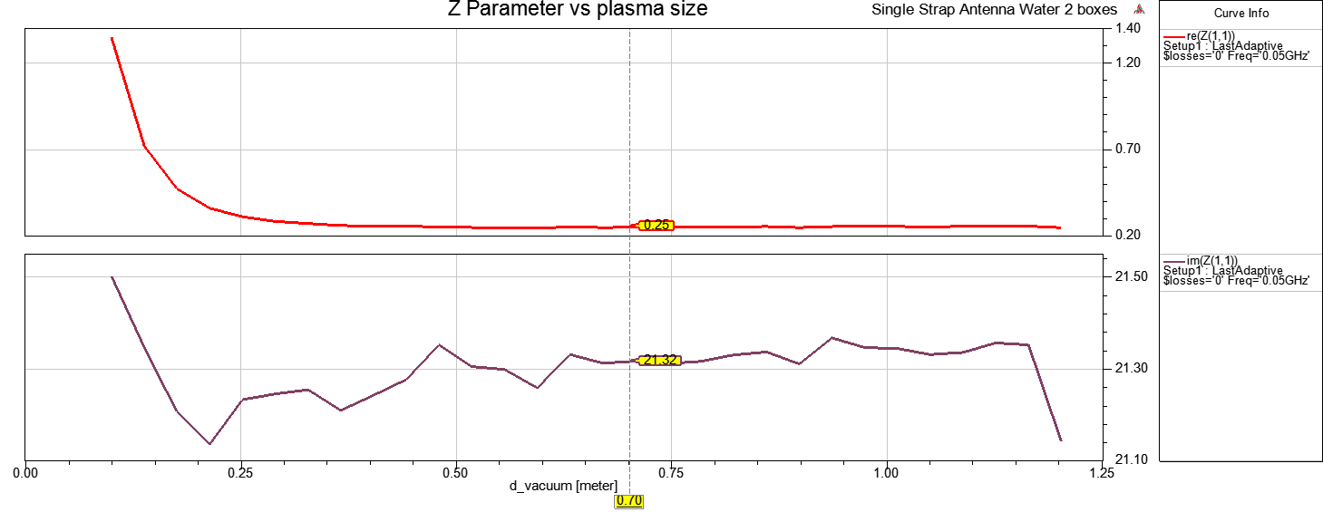
Convergence reached for D~>0.5m
« 1st Rule of thumb » : radiation medium size > 4 antenna box largest size (250mm here)
(lambda ~ 6m → ~ radiation medium size > lambda/6 at min?)
→ Target result for next simulations: Z=0.25+21.3j
Antenna box : d=0.16 m, h=0.25m
D [m]

Slide 5
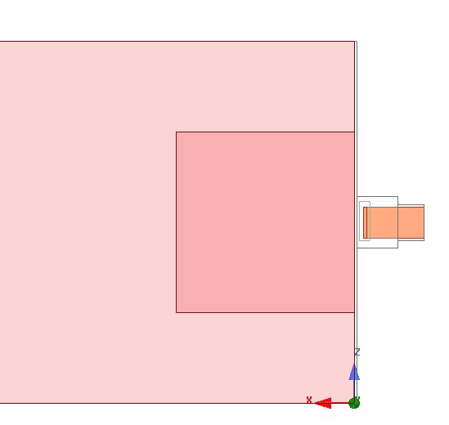
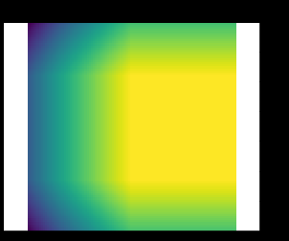
Step2 : creating a lossy plasma surrounding a low or non-lossy plasma
PerfectE BC
D
d
Plasma1,
Constant losses
ε"(x,z)
ε" = -0.1
Pin
Plasma2,
Increasing losses
Pout
Dummy boundary, close to PerfE BC

Slide 6
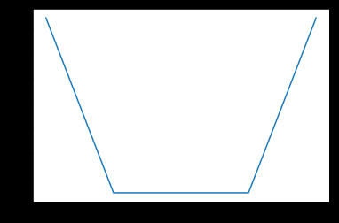
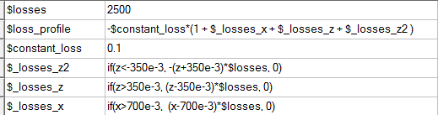
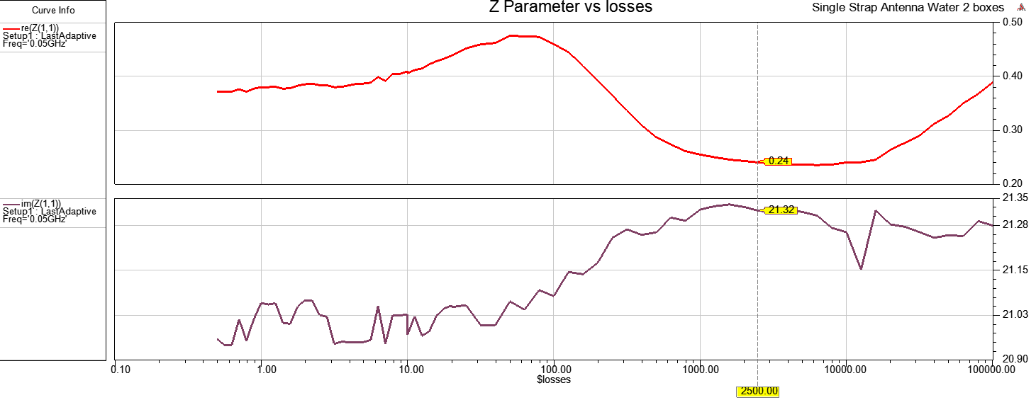
Linear loss evolution
2500

Slide 7
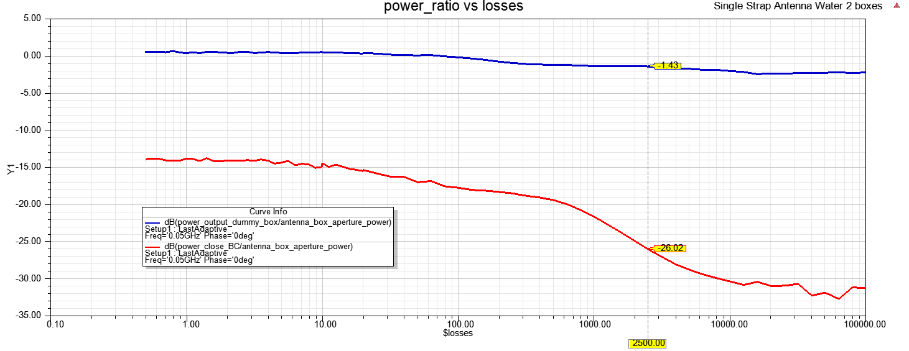
-30dB between antenna aperture and ~BC

Slide 8
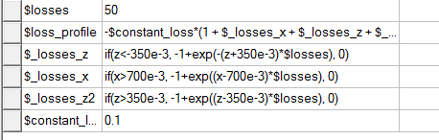
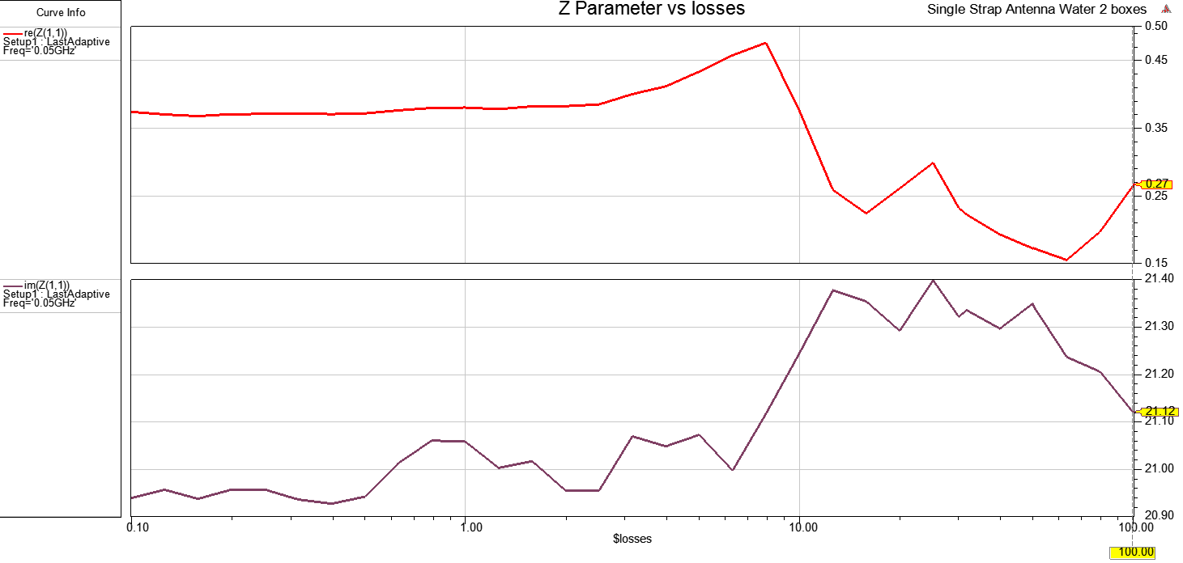
Exponential loss evolution

Slide 9
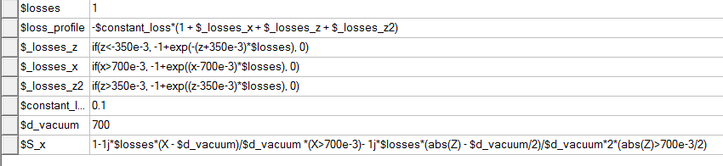
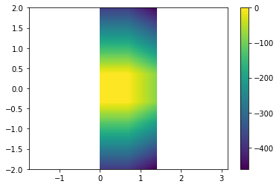
PML-like evolution
Epsr_HFSS = epsr . S(x)

Slide 10
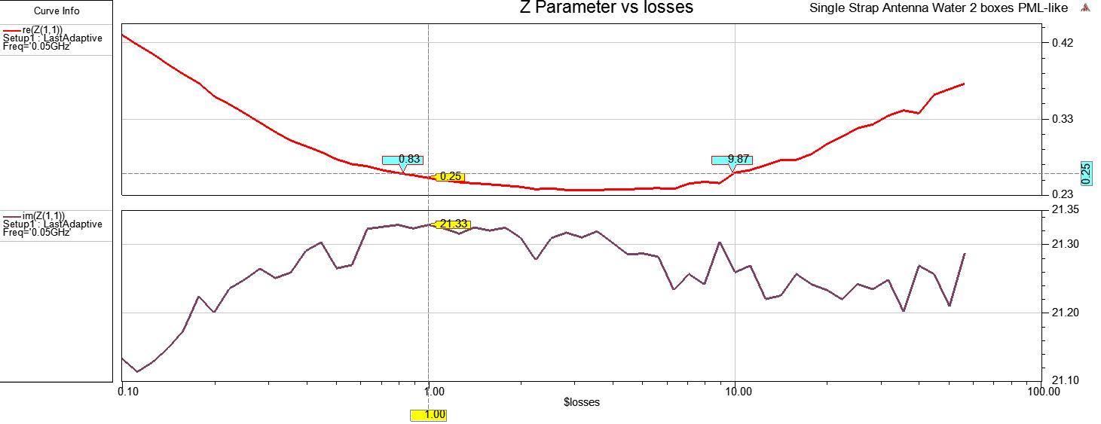
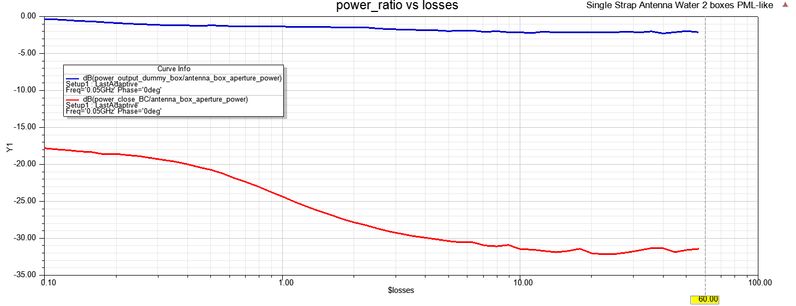
-25 dB

